Slide 1
Module 6: Linear Models for Classification
ISE-529
Content based on ISLR Chapter 4.1 – 4.3

Slide 2
Outline
Classification – Basic Theory
Logistic regression basic theory
Parameter estimation
Confounding
Classification from logistic regression models
Assessment
Misclassification Rate
Sensitivity/Specificity
Receiver Operating Characteristics (ROC) Charts and optimizing the classification threshold
Lift and Lift Curves

Slide 3
Data Mining Techniques Overview
Classification Analysis
The process of predicting the “class” (or label or group membership) of newly encountered entities based on analyzing known class membership of other similar types of entities.
Belongs to the group of techniques referred to as “supervised” learning
If classes are binary (pass/fail, purchase/no purchase, fraudulent/not fraudulent, it is referred to as “binary classification”
We will only be addressing binary classification in this module

Slide 4

Classification Examples
Credit Scoring
Can credit score and home ownership predict load default?
Predictor Variables:
Credit Score: 300–850
Home Ownership: Yes/No/Rent
Response Variable:
Loan Default: Yes/No

Slide 5

Classification Examples
Biostatistics
Are alcohol and smoking related to heart disease?
Predictor Variables:
Alcohol: ounces per day
Smoking: cigarettes per day
Response Variable:
Heart Disease: 1/0

Slide 6

Classification Examples
Campaign Marketing
Does a customer make a purchase based on past behavior?
Predictor Variables:
Purchases: total spent in past 90 days
Age Group: four levels
Gender: M/F
Response Variable:
Campaign: Yes/No

Slide 7
Classification
Similar to regression, objective is to develop a mathematical model of the relationship of one or more independent variables (or predictors or regressors or explanatory variables) to one dependent variable (or response variable).
However, in classification problems the dependent variable is a categorical attribute.
Common special case is where the dependent variable takes one of two possible values (true/false, pass/fail, sick/healthy, etc.) – referred to as binary classification
Generally, we are more interested in estimating the probabilities that the output belongs into each category level.
For example, it is more valuable to have an estimate of the probability that an insurance claim is fraudulent than just a classification of “Fraudulent”

Slide 8
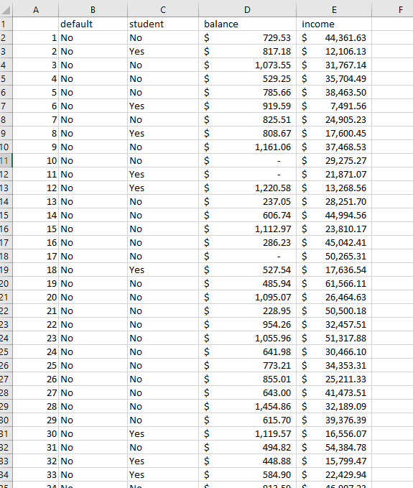
Classification Example
Credit Card Default

Slide 9
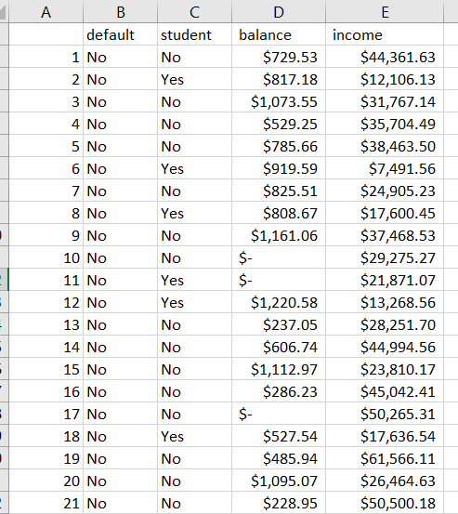
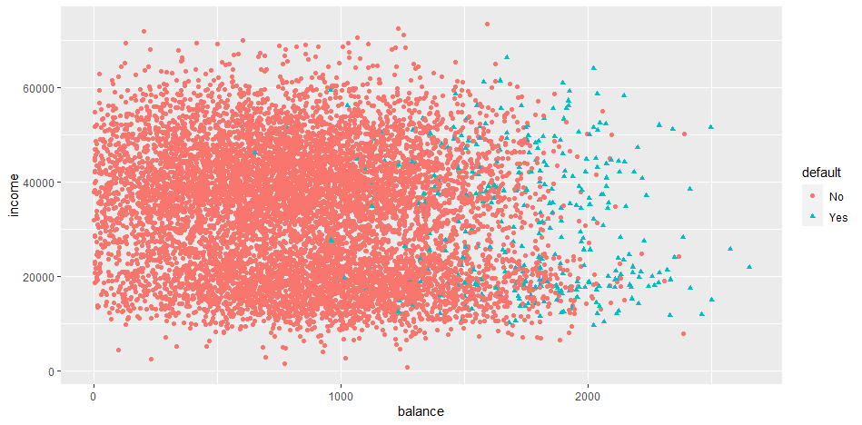
Classification Example
Credit Card Default Data.csv
Which factor (balance or income) has the stronger relation to default?

Slide 10
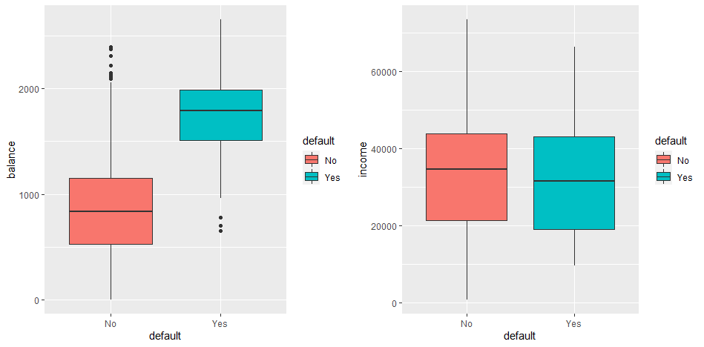
Classification Example
Credit Card Default Data.csv
Which factor (balance or income) has the stronger relation to default?

Slide 11
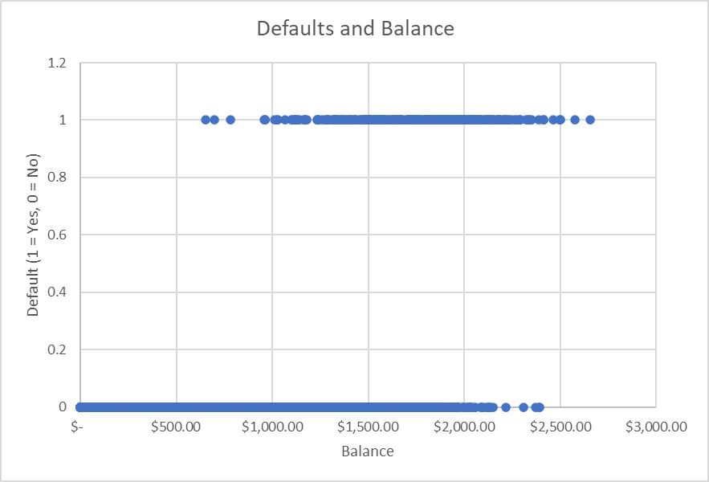
Classification Example
Scatterplot
P[Y = 1] increases with X?

Slide 12


Can’t We Just Use Linear Regression?
Suppose we code the dependent variable for an insurance claim as fraudulent as follows:
Can’t we simply perform a linear regression of Y on X and classify as Yes if $\hat{Y}>0.5$??
$$Y= \left\{\begin{matrix}0 if No \\ 1 if Yes\end{matrix}\right.$$

Slide 13
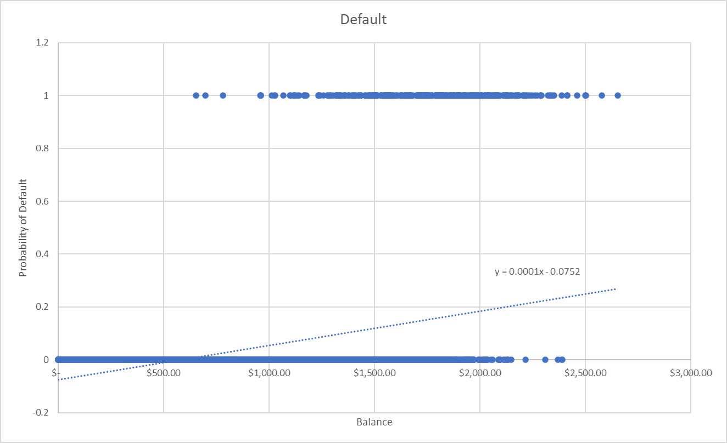
Issues With Using Linear Regression For Classification
Negative probability of default is meaningless!

Slide 14
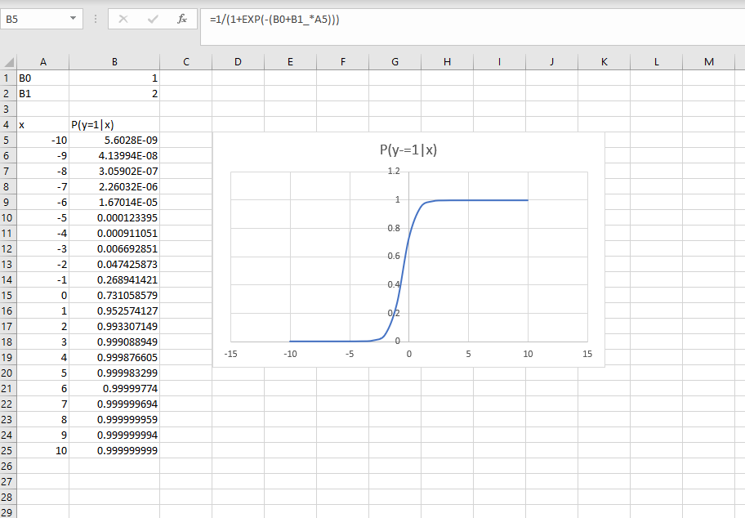
The Logistic Regression Model
Logistic regression is based on the assumption that a good mathematical model for a binary variable (with a single regressor) is:
$$p\left(X\right)≡P\left(Y=1 | X\right)= \frac{1}{1+ e^{−(β_{0}+β_{1}X)}}=\frac{e^{(β_{0}+β_{1}X)}}{1+e^{(β_{0}+β_{1}X)}}$$

Slide 15


The Logistic Regression Model
A bit of re-arrangement of $p\left(X\right)$ yields the log odds or logit function:
The logit function is referred to as the link function for logistic regressions.
Odds
$$\log\left(\frac{p\left(X\right)}{1−p\left(X\right)}\right)=β_{0}+β_{1}X$$
Logit Function

Slide 16
The Logistic Regression Model
A bit of re-arrangement of $p\left(X\right)$ yields the log odds or logit function:
The logit function is referred to as the link function for logistic regressions.
Odds
$$\log\left(\frac{p\left(X\right)}{1−p\left(X\right)}\right)=β_{0}+β_{1}X$$
Logit Function

Slide 17
Parameter Estimation

Slide 18

Parameter Estimation
Recall that for linear regression, we estimated the parameters based on minimizing the residuals sum of squares:
However, we cannot use that method for estimating the parameters of many models, including for logistic regressions
WHY???
Hint: remember that for linear regression, we are modeling the actual value of the output attribute. What are we modeling for logistic regression?
$$RSS= \sum_{i=1}^{n}{{ε_{i}}^{2}=}\sum_{i=1}^{n}{{{(y}_{i}−{\hat{β}}_{0}−{\hat{β}}_{1}x_{i}\text{) }}^{2}}$$

Slide 19
Parameter Estimation
In logistic regression, we are not modeling the value of an output attribute, we are modeling the probability that the output attribute takes on one of two possible states.
If we have enough data, we could observe the actual probabilities by counting the percentage of states for each given value of X
In practice, we generally use an alternate technique called Maximum Likelihood Estimation (MLE)

Slide 20
Parameter Estimation
Maximum Likelihood Estimation
In OLS (Ordinary Least Squares), we are trying to find the parameters of a line (or curve) that minimizes the sum of the squares of the differences between the estimation (given by the regression equation) and the actual data.
In MLE, we are trying to find the parameters of an equation that maximizes the probability of having actually observed the data that we observe (our training data)

Slide 21


Maximum Likelihood Estimation
Parameter estimation is performed by Maximum Likelihood Estimation
Calculate the probability of observing the data given estimated parameters
Find the parameter estimates that maximize that probability
For computational efficiency, we generally maximize the logarithm of this likelihood (referred to as the log-likelihood)
$$ℓ\left(β_{0}, β_{1},…\right)≡p(β_{0}, β_{1},…|X)=\prod_{i:y_{i}=1}{p(x_{i})}\prod_{i:y_{i}=0}{(1−p\left(x_{i}\right))}$$
$$ll\left(β_{0}, β_{1},…\right)=\sum_{i:y_{i}=1}{ln⁡(p\left(x_{i}\right))}\sum_{i:y_{i}=0}{ln⁡(1−p\left(x_{i}\right))}$$

Slide 22
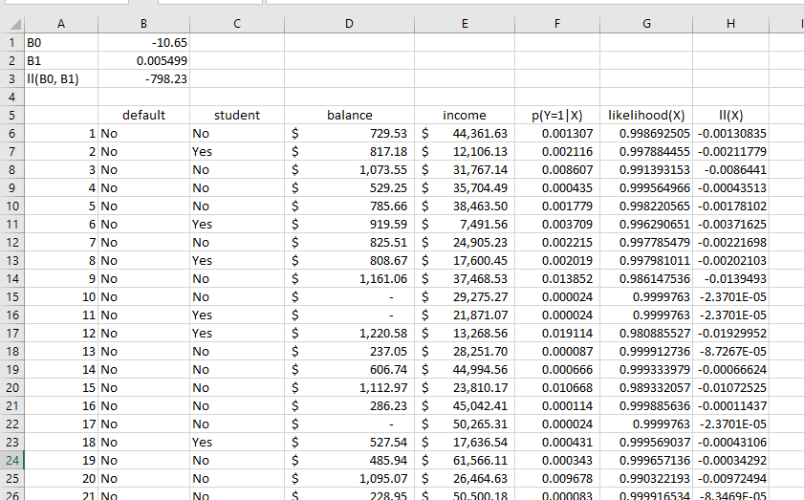
Maximum Likelihood Estimation
=1/(1+EXP(-(B0+B1_*D6)))
=IF(B6="Yes",F6,(1-F6))

Slide 23
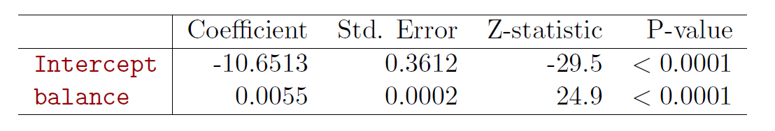
Maximum Likelihood Estimation
Interpreting standard regression coefficient statistics:
Std. Error – sample standard deviation (adjusted for sample size)
Roughly 95% of the observations fall within 2 Standard Errors of the estimated value
Z-statistic – Coefficient divided by the Std. Error
Number of standard errors the coefficient is away from zero
Looking for a number greater than 2 or 3 for significance of the coefficient
P-value – probability that the true coefficient is zero
Looking for a value less than 0.05 or 0.01

Slide 24

Making Predictions
Once the parameters have been estimated, it is straightforward to make a prediction on a new case by plugging the values of the parameters and independent variable(s) into the logistic regression equation:
$$p\left(X\right)≡P\left(Y=1 | X\right)= \frac{e^{(β_{0}+β_{1}X)}}{1+e^{(β_{0}+β_{1}X)}}$$

Slide 25
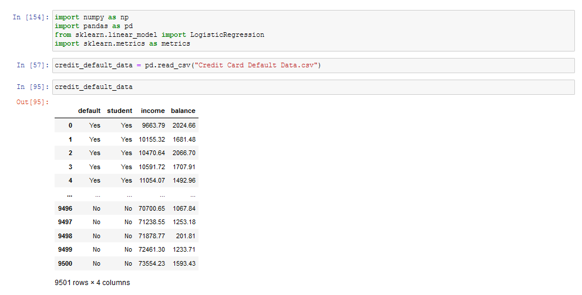
Example
Scikit-Learn Logistic Regression

Slide 26
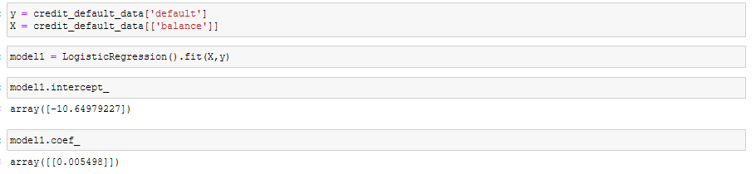

Example
Scikit-Learn Logistic Regression
Consider the example of predicting loan defaults based on loan balance:
$p\left(X\right)=\frac{e^{(−10.65+0.0055X)}}{{1+e}^{(−10.65+0.0055X)}}$

Slide 27


Example
What is the estimated probability of default for someone with a balance of $1000?
What is the estimated probability of default for someone with a balance of $2000?
$p\left(X\right)\frac{e^{(−10.65+0.0055∗1000)}}{{1+e}^{(−10.65+0.0055∗1000)}}$ = 0.006
$p\left(X\right)\frac{e^{(−10.65+0.005∗2000)}}{{1+e}^{(−10.65+0.005∗2000)}}$ = 0.586

Slide 28
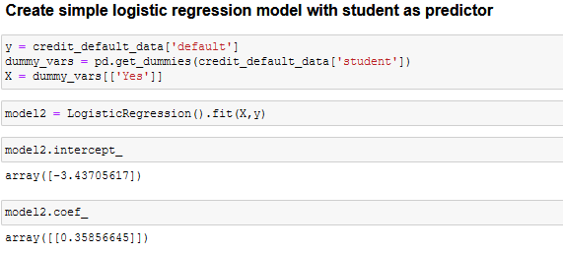

Example
Scikit-Learn Logistic Regression
Consider the example of predicting loan defaults based on student status:
$p\left(X\right)=\frac{e^{(−3.44 + 0.359X)}}{1 + e^{(−3.44 + 0.359X)}}$

Slide 29
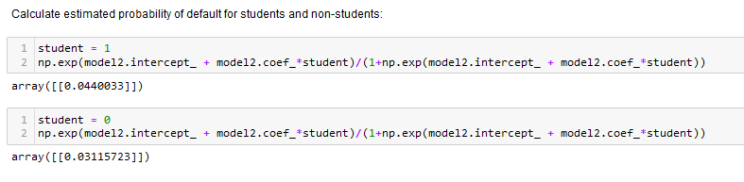

Default Example
Using Student as Predictor
$$P(default | student = Yes)=0.044$$
$$P(default | student =No)=0.031$$

Slide 30
Interpreting Coefficients

Slide 31

Interpreting Coefficients
Understanding Odds and Odds Ratios
Odds
$$\log\left(\frac{p\left(Y\right)}{1−p\left(Y\right)}\right)=β_{0}+β_{1}X$$
Logit Function

Slide 32

Odds Ratios
A random event may be observed with probability $π$
The odds ratio (or just “odds”) is an expression of how much more likely an event is to occur than not occur
Closely tied with gambling where payoffs are based on odds ratios

Slide 33

Odds Ratios
Mathematically:
Example, polls indicate:
There is a 2/3 chance of candidate A winning
There is a 1/3 chance of candidate B winning
The odds of candidate A winning are “two to one”, or 2:1
$$Odds\left[A\right]= \frac{π}{1−π}$$

Slide 34

Interpreting Coefficients
Odds Ratios
An odds ratio quantifies that strength of the association between two events and is defined as the ratio of the odds of Y in the presence of X to the odds of Y in the absence of X:
$$odds ratio= \frac{odds(Y=1|X=1)}{odds(Y=1|X=0)}$$
Thus, if the odds ratio is 2, it is twice as likely that Y=1 when X=1 than when X = 0.
Why do we care??

Slide 35


Interpreting Coefficients
Binary Factor Variable X
Some basic algebraic manipulations indicate that the coefficient $β_{j}$ in the logistic regression is the log of the odds ratio for $X_{j}$:
=1
$$\frac{odds(β_{0}+…+β_{j}{(X}_{j})+ …+β_{p}X_{p})}{odds(β_{0}+…+β_{j}{(X}_{j})+ …+β_{p}X_{p})}=\frac{e^{(β_{0}+…+β_{j}∗1+ …+β_{p}X_{p})}}{e^{(β_{0}+…+β_{j}∗0+ …+β_{p}X_{p})}}= e^{β_{j}}$$
=0
Thus, the coefficient $β_{j}$ in the logistic regression is the log of the odds ratio for $X_{j}$:
$$\left(\frac{odds\left(X_{j}=1\right) }{odds\left(X_{j}=0\right) }\right)= e^{β_{j}}$$

Slide 36
Odds and Odds Ratios
English Language Usage – Odds Ratios
Consider the odds ratio of the odds of default if student status = 1:
If it were 1.5, we would simply say that the odds of default are 1.5 times higher if the borrower is a student than if the borrow is not

Slide 37



Interpreting the Regression Coefficient
Student Status as Predictor
$p\left(X\right)=\frac{e^{(−3.44 + 0.359X)}}{1 + e^{(−3.44 + 0.359X)}}$
Recall:
log($\frac{odds(X_{j}=1) }{odds(X_{j}=0) }$) = $β_{j}$ = 0.359
The odds of the result (default) are 1.43 times higher if the borrower is a student than if not
$$\frac{odds(X_{j}=1) }{odds(X_{j}=0) }= e^{0.359}=1.43$$

Slide 38


Interpreting Coefficients
Continuous Variable $X_{j}$
Similarly, for a continuous variable $X_{j}$ if the value of $X_{j}$ increases by 1:
$$\frac{odds(β_{0}+β_{j}{(X}_{j}+1)+ …+β_{p}X_{p})}{odds(β_{0}+β_{j}X_{j}+ …+β_{p}X_{p})}=\frac{e^{β_{0}+β_{j}{(X}_{j}+1)+ …+β_{p}X_{p}}}{e^{β_{0}+β_{j}X_{j}+ …+β_{p}X_{p}}}= e^{β_{j}}$$
Thus, the coefficient $β_{j}$ in the logistic regression is the log of the odds ratio for an increase by 1 for the value $X_{j}$:
$$\frac{odds(X_{j}+1) }{odds(X_{j}) }= e^{β_{j}}$$

Slide 39
Confounding

Slide 40
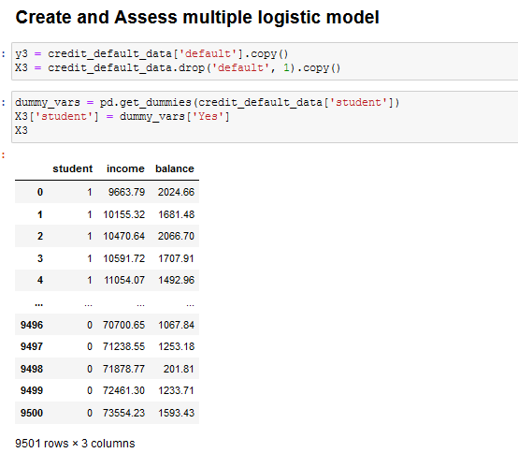
Multiple Logistic Regression
Making a model for loan default based on balance, income, and student status:

Slide 41
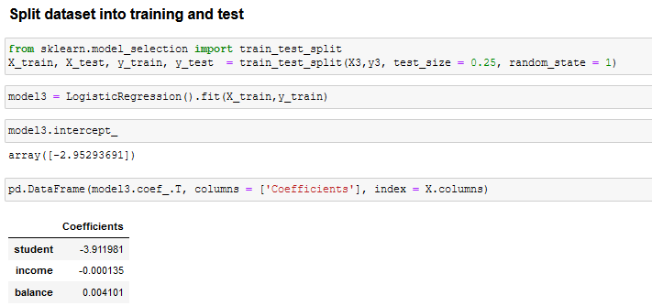
Multiple Logistic Regression
Making a model for loan default based on balance, income, and student status:
Why is the parameter on student negative here when it was positive as part of a Simple Logistic Regression??

Slide 42
Confounding
This is an example of confounding
Combining factors that are correlated in such a way as to distort the true relationship.
In this example, student status is confounded with balance levels
Without considering other factors, students have higher chance of default
Considering balance as an additional factor, students have lower chance of default compared with non-students who hold the same balance
Generally, students hold a higher balance and consequently overall higher chance of default. In other words, balance and student status are positively correlated

Slide 43
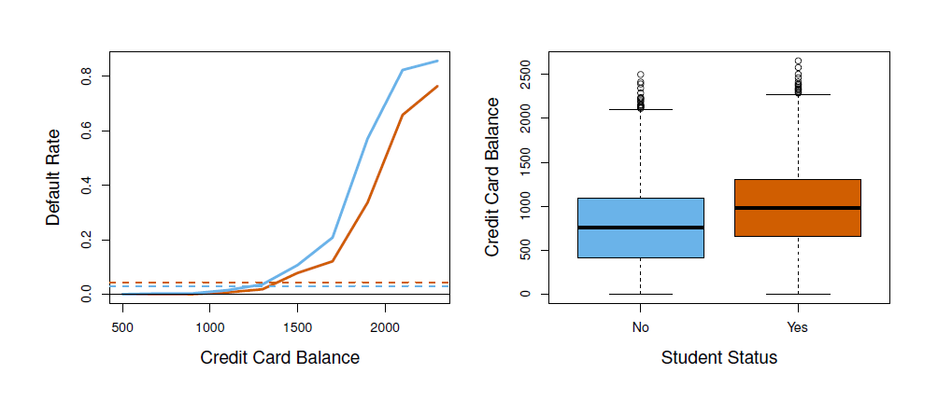
Confounding
Left: Default rates are shown for students (orange) and non-students (blue). The solid lines display default rate as a function of balance, while the horizontal broken lines display the overall default rates.
Right: Boxplots of balance for students (orange) and non-students (blue) are shown.
Chapter

Slide 44
Confounding
Confounding occurs when one predictor variable influences both another predictor variable and the response variable
Example: predicting drug effectiveness
What if gender influences a patient’s choice of drug?
Gender
Drug
Recovery

Slide 45
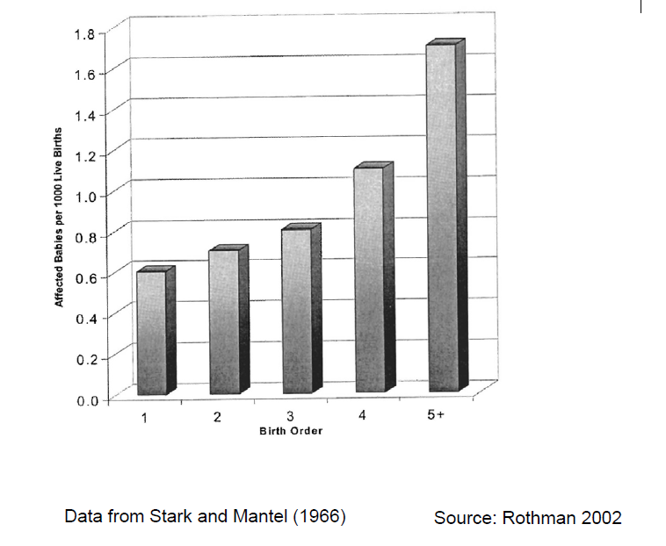
Confounding Example
Association Between Birth Order and Down Syndrome

Slide 46
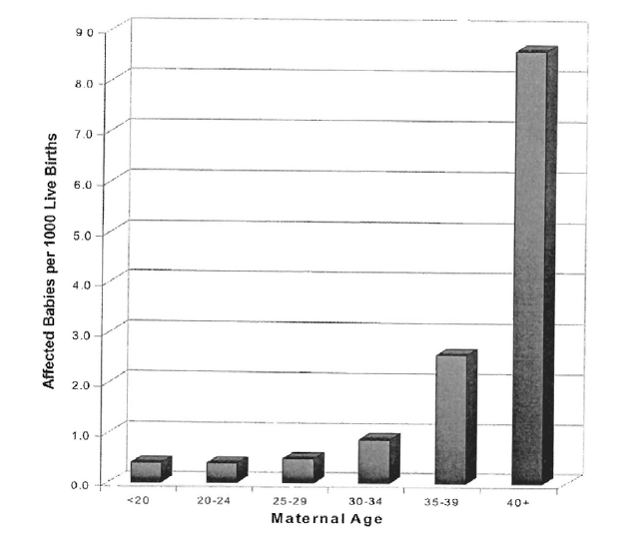
Confounding Example
Association Between Maternal Age and Down Syndrome

Slide 47
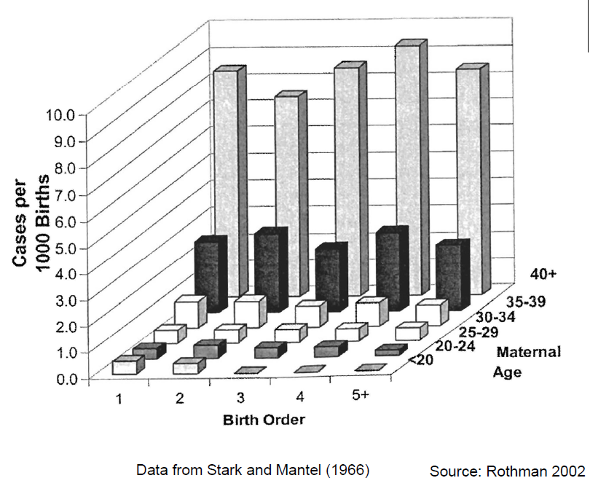
Confounding Example
Association Between Birth Order and Down Syndrome

Slide 48
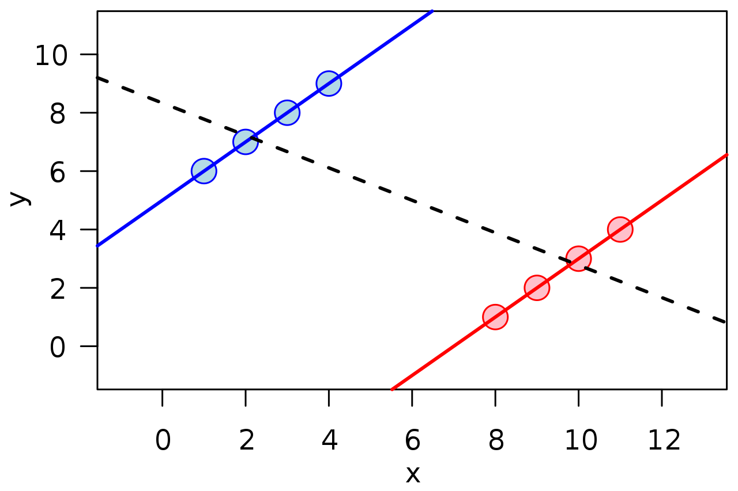
Simpson’s Paradox
A trend observed in an overall dataset disappears or reverses when the trend is observed by groups

Slide 49
Confounding
“Confounding, the situation in which an apparent effect of an exposure on risk is explained by its association with other factors, is probably the most important cause of spurious associations in observational epidemiology”
BMJ Editorial: “The Scandal of Poor Epidemiological Research”, 16 October 2004
Randomized clinical trials (RCTs) attempt to avoid or minimize confounding through randomization and matching techniques
As opposed to “observational studies”

Slide 50
Model Assessment

Slide 51
Assessment Measures (Fit Statistics)
Binary Targets
The techniques that are used to model fit assessment for regression models do not apply for classification models (why?)
Three types of assessment measures for binary classification models:
Classification accuracy: Accuracy in predicting the actual category result (0/1, True/False, Churn/No Churn, etc.)
Ranking predictions: Accuracy of the rankings of the likelihood of the event
Estimate predictions: Accuracy of the actual probability predictions

Slide 52
Model Assessment Overview
Classification Accuracy
Focus is on “misclassification rate” – what percentage of our predictions are wrong?
Key statistics
“Confusion matrix”
Sensitivity/specificity
Key assessment graphs
Receiver Operating Characteristics (ROC) curves
Lift curves

Slide 53


Classification Predictions
Confusion Matrix
 |  | Actual Classification
 |  | Negative | Positive | Totals
Predicted Classification | Negative | TN (# true negatives) | FN (# false negatives) | N (# true negatives)
 | Positive | FP (# false positives) | TP (# true positives) | P (# true positives)
$$\text{Sensitivity}=\frac{\text{TP}}{\text{TP}+\text{FN}}$$
$$\text{Specificity}=\frac{\text{TN}}{\text{TN}+\text{FP}}$$

Slide 54
Classification Predictions
Sensitivity: what percentage of the positive outcomes do we correctly identify?
Does the classifier capture most of the important events?
Specificity: what percentage of the negative outcomes do we correctly identify?
Does the classifier “weed out” most of the unimportant events?

Slide 55
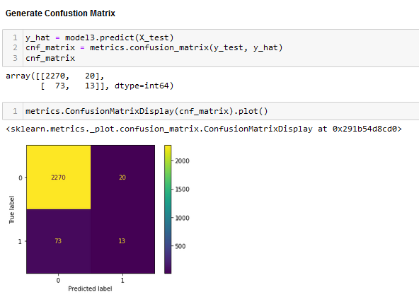
Classification – Assessment Techniques
Confusion Matrix

Slide 56
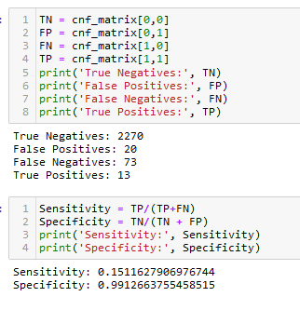
Classification – Assessment Techniques
Metrics
Is this good performance?

Slide 57
Classifier
There is generally a tradeoff between sensitivity and specificity
After modeling the probability of an event, we must decide on the “discrimination threshold” we will use
Typically, 50% is used
Why would we want to use anything else?
Adjusting the discrimination threshold allows the data scientist to fine tune the model to get the desired balance between sensitivity and specificity

Slide 58
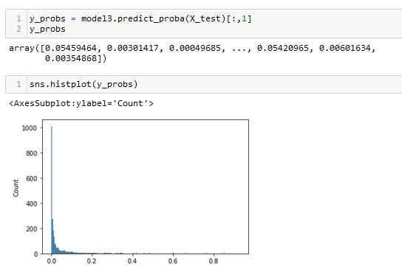
Classifier
Looking at Prediction Probabilities

Slide 59
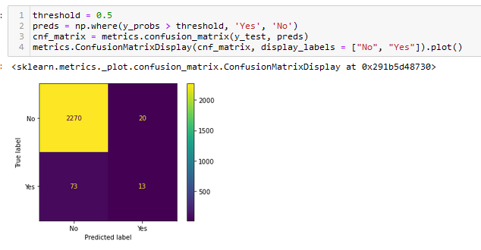
Classifier
Adjusting Discrimination Threshold
Sklearn does not have a built-in parameter to specify a discrimination threshold, but it is easy to implement:

Slide 60
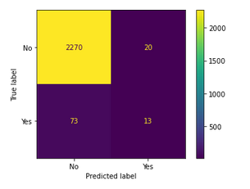
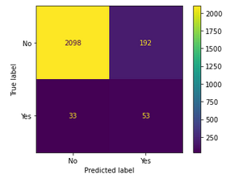
Classifier
There is generally a tradeoff between sensitivity and specificity
Adjusting the discrimination threshold allows the data scientist to fine tune the model to get the desired balance between sensitivity and specificity
Threshold = 0.5
Threshold = 0.1
With a 0.5 classification threshold, we "miss" 73 true positives
With a 0.1 classification threshold, we capture an additional 40 true positives, but at the cost of having to look at 192 false positives

Slide 61


Classifier
Comparing Thresholds
Threshold = 0.5
Threshold = 0.1
With a 0.5 classification threshold, we "miss" 73 true positives
With a 0.1 classification threshold, we capture an additional 40 true positives, but at the cost of having to look at 192 false positives

Slide 62
Classification Assessment Visualizations
ROC Chart
Graphical plot to assist in optimizing the sensitivity/specificity tradeoff
Plots the True Positive Rate (sensitivity) against the False Positive Rate (1-specificity) at each possible value of the discrimination threshold.

Slide 63
ROC Curve

Slide 64
ROC Curve

Slide 65
ROC Curve

Slide 66
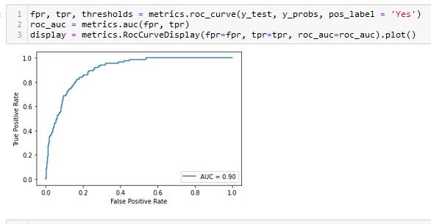
ROC Curve
Loan Default Example

Slide 67
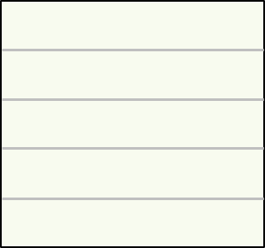
Ranking Predictions
ROC Index / C Statistic
weak model
C-statistic < 0.6
strong model
C-statistic > 0.7
Notes:
ecpml8306_1_e
[ROC Chart and the C-Statistic]
The area under the ROC curve is a measure also known as the C-statistic or the ROC index. The larger the area under the curve, the higher the C-statistic and the better the model's classification accuracy.
Models whose true positive rates and false positive rates are approximately equal are weak models. As the chart on the left shows, a weak model has a curve that is close to the diagonal between the lower left corner and the upper right corner. This weak model has a C-statistic less than 0.6. Models that have much higher true positive rates than false positive rates for all cutoffs are strong models, as shown in the chart on the right. Notice that the curve approaches the upper left corner.
This strong model has a C-statistic greater than 0.7. The area under the ROC curve summarizes the tradeoff between the primary versus secondary cases that are captured.
[Dev Note 3/8/19. Audio pickup ecpml8306_1_e_x4. 5 sentences (above) replace 3 sentences of old audio shown below.
Old audio to replace: "Models whose true positive rates and false positive rates are approximately equal to the cutoffs are weak models, as shown in the chart on the left. This weak model has a C-statistic less than 0.6. Models that have much higher true positive rates than false positive rates for all cutoffs are strong models, as shown in the chart on the right. "
[Dev Note 1/30/19. See issue 122. Add pickup ecpml8306_1_e_x3. Replace multiple sentences of old audio, shown below, with more sentences, shown above. NOTE: This was INCORRECTLY recorded in _x2 on 1/30. Use the _x3 file instead. ALSO recapture this slide: I switched the order of the yellow callouts and, in the labels under the graphs, changed "ROC index" to "C-statistic".
The area under the ROC curve is a measure known as the ROC index or the C-statistic. The larger the area under the curve, the higher the ROC index.
Models that capture primary and secondary outcome cases in a proportion approximately equal to the cutoff are weak models, as shown in the chart on the left. Models that capture mostly primary outcome cases without capturing secondary outcome cases are strong models, as shown in the chart on the right. The area under the ROC curve summarizes the tradeoff between primary and secondary case capture.
]

Slide 68
Lift
Background: many classification applications involve looking for relatively low probability, but important events, for example:
Fraudulent tax returns
Diseases
People likely to default on a loan
We want to identify a group of cases for more in-depth investigation, but we are limited in our ability to perform a large number of investigations. Therefore, we want our classifier to select a group with a high number of "true positive" outcomes

Slide 69
Model Lift
Another measure of the performance of a classification model (or an association rule model) that measures the "lift" or "improvement" a model provides over randomly selecting observations.
Example:
Your dataset of 1000 cases has 100 "true positives"
Randomly selecting 100 cases could thus be expected to return 10 positives
If your classifier takes its 100 "highest probability" cases and returns 40 positives, the lift would be 4.
Lift curves display a curve of the performance of a classifier for increasing size "bins" – your top 5%, 10%, of cases, etc.

Slide 70
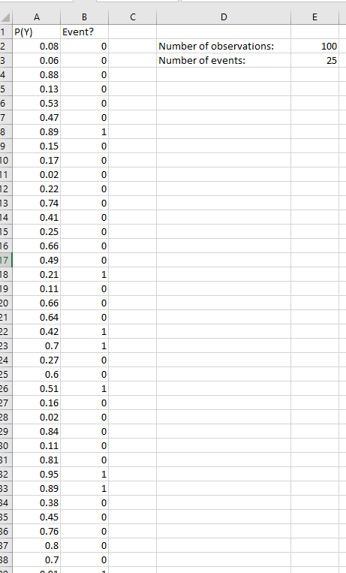
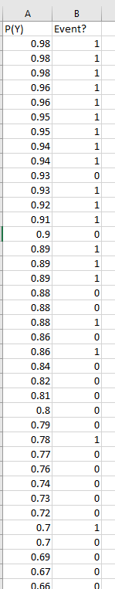
Lift Curve – Model Lift
Sort by decreasing model probability
# of events in top 5% high probability observations: 5
# of events (on average) in a random sample of 5% of observations?
1.25
Model lift at 5%:
5/1.25 = 4

Slide 71
Lift Curve – Model Lift
Sort by decreasing model probability
# of events in top 10% high probability observations: 9
# of events (on average) in a random sample of 5% of observations?
2.5
Model lift at 5%:
9/2.5 = 3.6

Slide 72
“Best” Lift
Performs the same calculation, as model lift except that it is calculated as though a sorting by probability ends up with all the positives (1s) on the top and all the negatives (0s) on the bottom

Slide 73
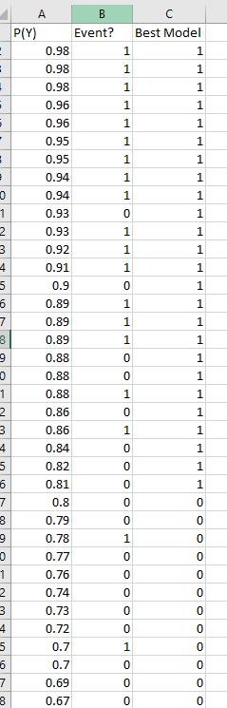
Lift Curve – Best Lift
# of events in first 5% observations: 5
# of events (on average) in a random sample of 5% of observations?
1.25
Best lift at 5%:
5/1.25 = 4

Slide 74
Lift Curve – Best Lift
# of events in first 10% observations: 10
# of events (on average) in a random sample of 10% of observations?
2.5
Best lift at 10%:
10/2.5 = 4

Slide 75
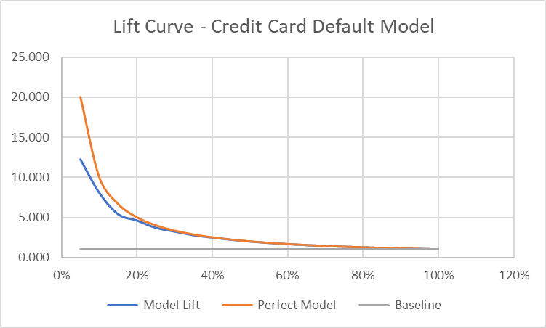
Lift Curve – Credit Card Default Model
Percentile | Random | Model | Model Lift | Perfect Model | Baseline
5% | 16.65 | 204 | 12.252 | 20 | 1
10% | 33.3 | 269 | 8.078 | 10 | 1
15% | 49.95 | 270 | 5.405 | 6.666666667 | 1
20% | 66.6 | 307 | 4.610 | 5 | 1
25% | 83.25 | 308 | 3.700 | 4 | 1
30% | 99.9 | 323 | 3.233 | 3.333333333 | 1
35% | 116.55 | 323 | 2.771 | 2.857142857 | 1
40% | 133.2 | 330 | 2.477 | 2.5 | 1
45% | 149.85 | 330 | 2.202 | 2.222222222 | 1
50% | 166.5 | 330 | 1.982 | 2 | 1
55% | 183.15 | 330 | 1.802 | 1.818181818 | 1
60% | 199.8 | 332 | 1.662 | 1.666666667 | 1
65% | 216.45 | 332 | 1.534 | 1.538461538 | 1
70% | 233.1 | 333 | 1.429 | 1.428571429 | 1
75% | 249.75 | 333 | 1.333 | 1.333333333 | 1
80% | 266.4 | 333 | 1.250 | 1.25 | 1
85% | 283.05 | 333 | 1.176 | 1.176470588 | 1
90% | 299.7 | 333 | 1.111 | 1.111111111 | 1
95% | 316.35 | 333 | 1.053 | 1.052631579 | 1
100% | 333 | 333 | 1.000 | 1 | 1

Slide 76
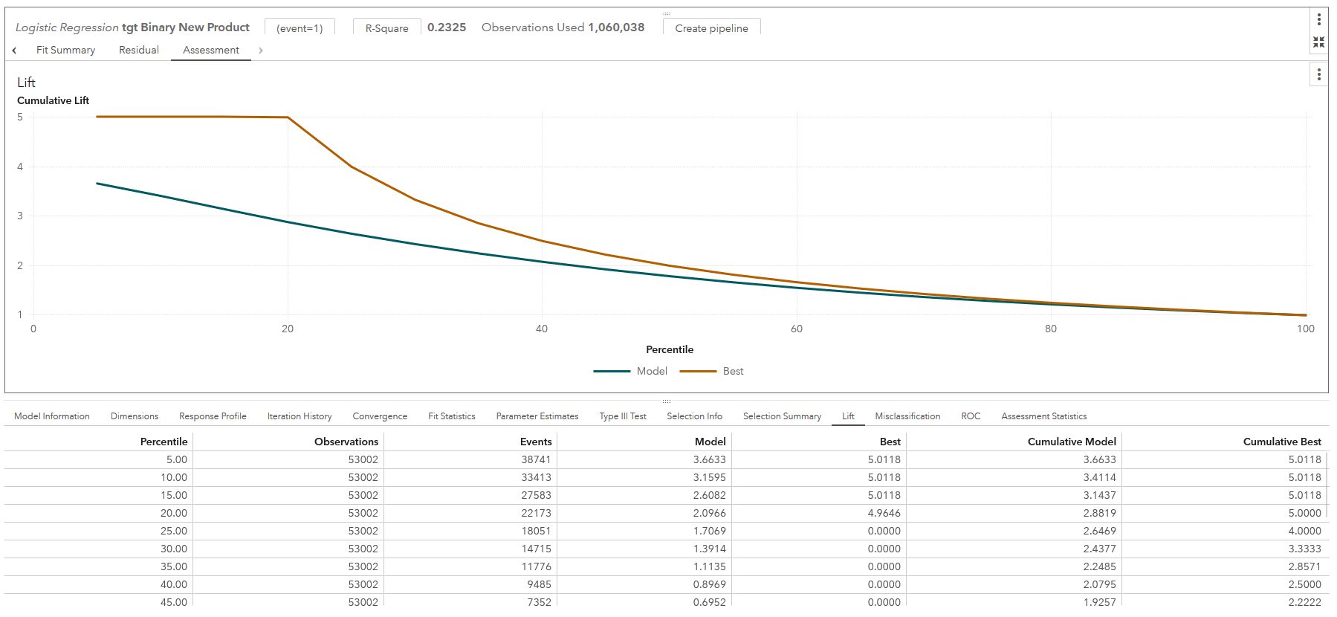
Logistic Regression Results: Lift
“Model” lift – ratio between the number of “events” identified in the model versus the number that would have been in a random drawing.
“Best” – ratio for a perfect model
In this example in the first bin of 53002 observations which the model assigned the highest probability to:
38,741 of the 53,002 observations contained the event
In a random draw of 53,002 observations, 10,575 observations would have contained the event (based on overall response profile)
Thus, model lift at 5% = 38,741/10,575 = 3.7
In the second bin (10%) of 53002 observations which the model assigned the highest probability to:
33,413 of the 53,002 observations contained the event
Thus, in the first two bins cumulatively, 72,154 observations would have contained the event
Thus, model lift at 10% = 72,154/21,150 = 3.4
Notes:
TAG_Print:
Put most simply, a lift chart is a graphical representation of the advantage (or lift) of using a predictive model to improve upon target response versus not using a model.
Technically, lift is the ratio of the percent of captured responses within each percentile bin to the average percent of responses for the model. Similarly, cumulative lift is calculated by using all of the data up to and including the current percentile bin. The default lift chart displays the cumulative lift of the model.
The chart shows two lines, one that represents the model you’ve built, and one that represents the best model achievable, or a perfect classifier. The closer the Model line is to the Best line, especially in the lower percentiles, the better the model.
Left-click on Cumulative along the Y axis to switch between a Cumulative chart and Lift chart (noncumulative).
TAG_Instructor:
12AUG14 – removed the last sentence - The bigger the difference between the Model and Best lines, especially at the lower percentiles, the better the model. The location where the lift chart begins to decrease indicates where the predictive value of the model diminishes.
Added this sentence - The chart shows two lines, one that represents the model you’ve built, and one that represents the best model achievable, or a perfect classifier. The closer the Model line is to the Best line, especially in the lower percentiles, the better the model.
Updated screenshot 07JUL2014. – to show how you can change between lift and cumulative lift.

Slide 77
Other Classification Model Assessment Statistics

Slide 78
Assessment Measures (Fit Statistics)
Binary Targets
Prediction Type
Fit Statistic
Accuracy/Misclassification
KS Youden
Decisions
Maximum distance from ROC curve to diagonal
ROC Index
Gini Coefficient
Area under ROC curve
Rankings
Concordance statistic
Average Squared Error
RMSE/SBC/AIC/Likelihood
Estimates

Slide 79
Ranking Predictions
Concordance Statistic / Gini Index
Essentially a correlation coefficient between the predicted and actual order
Not always able to determine the actual order

Slide 80


Estimate Prediction
Average Squared Error
$${ASE}_{cat}=\sum_{i=1}^{N}{\sum_{j=1}^{J}{\frac{{(δ_{ij}−{\hat{p}}_{ij})}^{2}}{JN}}}$$
$J:$ Number of target values (classes)
$δ_{ij}$: Equals 1 if value $j$ occurs in observation $i$, 0 if not
${\hat{p}}_{ij}$: Predicted probability of nominal target value $j$ for observation $i$

Slide 81

Which Assessment Measure Should You Use?
target measurement scale
prediction type
Inputs |  |  |  | Target
■ | ■ | ■ | ■ | ■
■ | ■ | ■ | ■ | ■
■ | ■ | ■ | ■ | ■
■ | ■ | ■ | ■ | ■
Predictions
■
■
■
■
assessment
measure

Slide 82




Evaluation of Model Performance
?
Assessment measures and statistical graphics of performance
Business needs
Speed of training
Speed of scoring
Feasibility of deployment
Noise tolerance
Interpretability
?
?
?

Slide 83
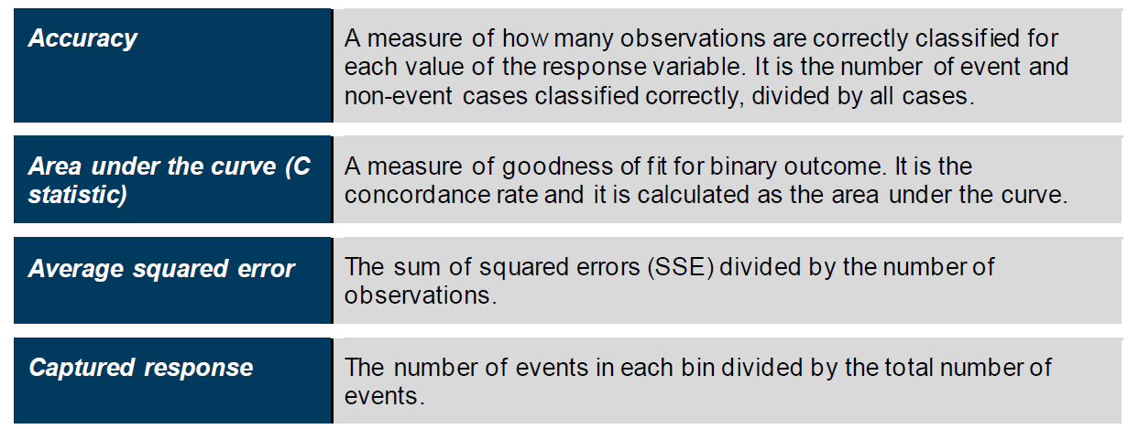
Model Assessment Statistics
Classification Models

Slide 84
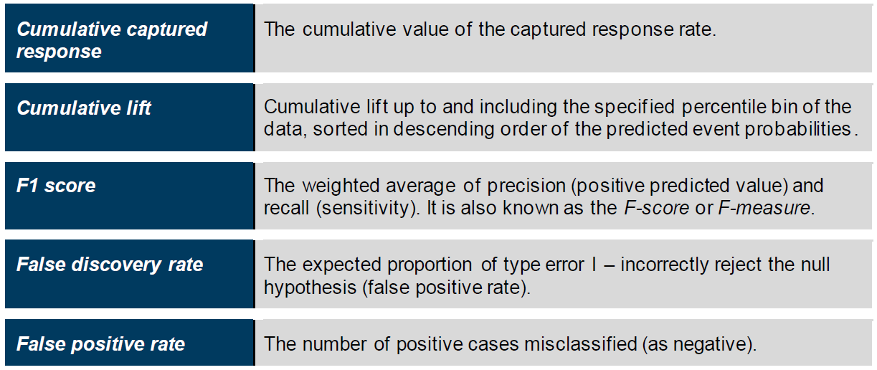
Model Assessment Statistics
Classification Models

Slide 85
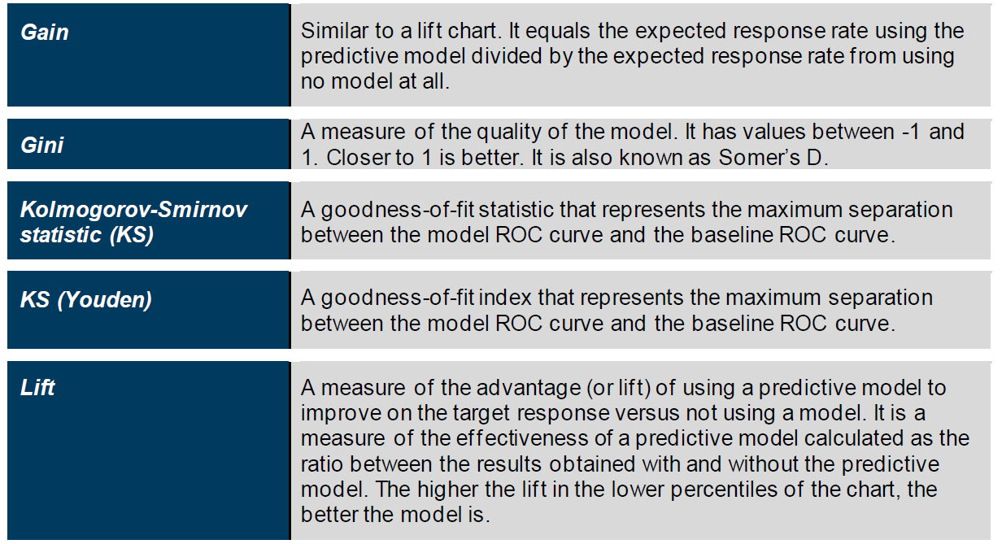
Model Assessment Statistics
Classification Models

Slide 86
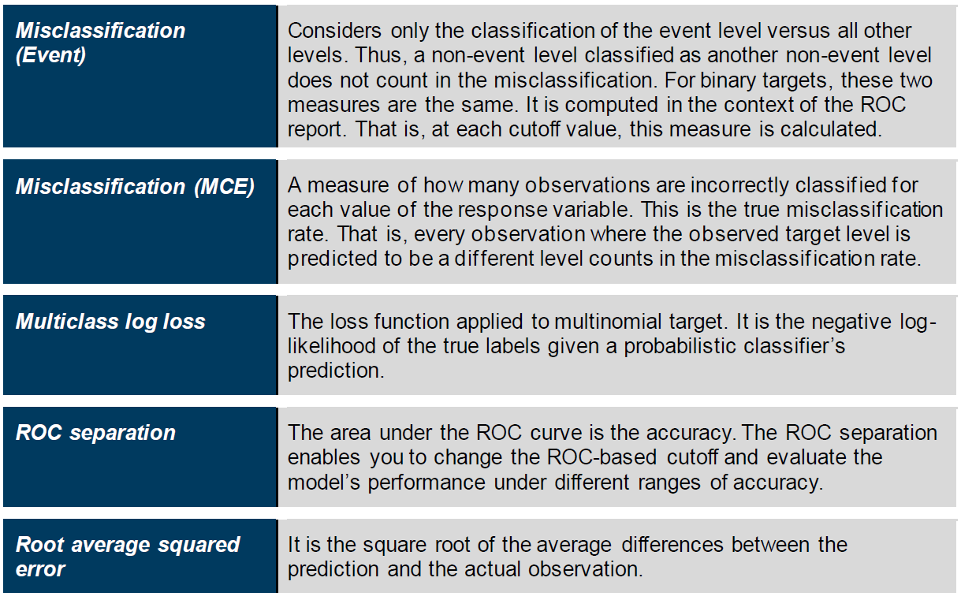
Model Assessment Statistics
Classification Models

Slide 87
Dataset Partitioning Considerations

Slide 88
Addressing Rare Events
Special handling is required when the target of interest is a rare event relative to the total number of samples
For example, detecting fraudulent activity
“Fitting a model without accounting for the extreme imbalance in the occurrence of the event gives you a model that is extremely accurate at telling you absolutely nothing of value”

Slide 89
Addressing Rare Events
A common practice is to build models from a sample with a primary outcome proportion different from the true population (“Event-Based Sampling”)
It can be shown that you can obtain a model of similar predictive power with a smaller overall case count
The amount of information in a data set with a categorical outcome is determined not by the total number of cases in the data set, but by the number of cases in the rarest outcome category

Slide 90
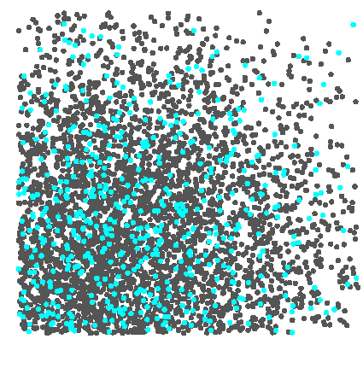
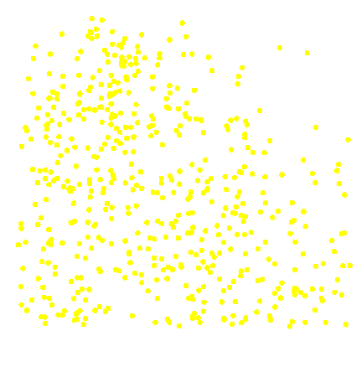
Addressing Rare Events
Event-Based Sampling
Secondary Outcome
Primary Outcome
Select some cases
Select all cases

Slide 91
Addressing Rare Events
Event-Based Sampling
Similar predictive power with smaller case count
Must adjust assessment measures and graphics
Must adjust prediction estimates for bias
Model Studio automatically adjusts for event-based sampling

Slide 92
Dataset Partition Strategies
Partition data / address rare events
Stratified sampling: ensure partitions have same percentages (of a category) as the overall population
Event-based sampling: Over/under sample to get specified percentages of each category of observations in each partition

Slide 93
Multinomial Logistic Regression

Slide 94

Multinomial Logistic Regression
Overview
Extension of logistic regression for multiple categories
Select a single class to serve as the baseline (here, we select K):
$$P\left(Y=k | X=x\right)= \frac{e^{(β_{k0}+β_{k1}x_{1}+…+β_{kp}x_{p})}}{1+e^{(β_{k0}+β_{k1}x_{1}+…+β_{kp}x_{p})}}$$
for k = 1, …, K-1, and
$$P\left(Y=K | X=x\right)= \frac{1}{1+e^{(β_{k0}+β_{k1}x_{1}+…+β_{kp}x_{p})}}$$

Slide 95
Module 7
Generalized Linear Models

Slide 96
Generalized Linear Models
Overview
Covers cases where the response variable Y is neither qualitative or quantitative
For example, count variables

Slide 97
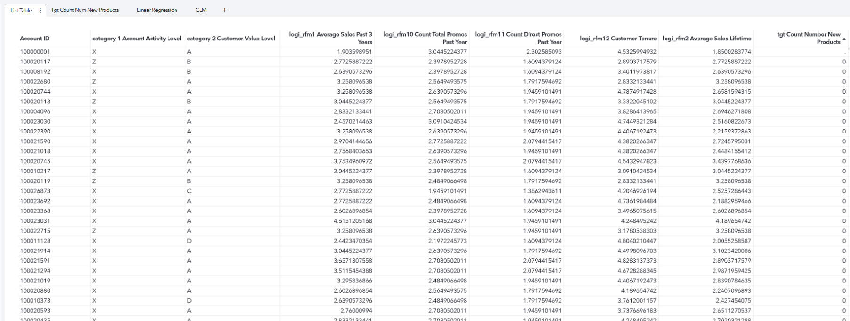
Example
VS_Bank Campaign Response Data

Slide 98
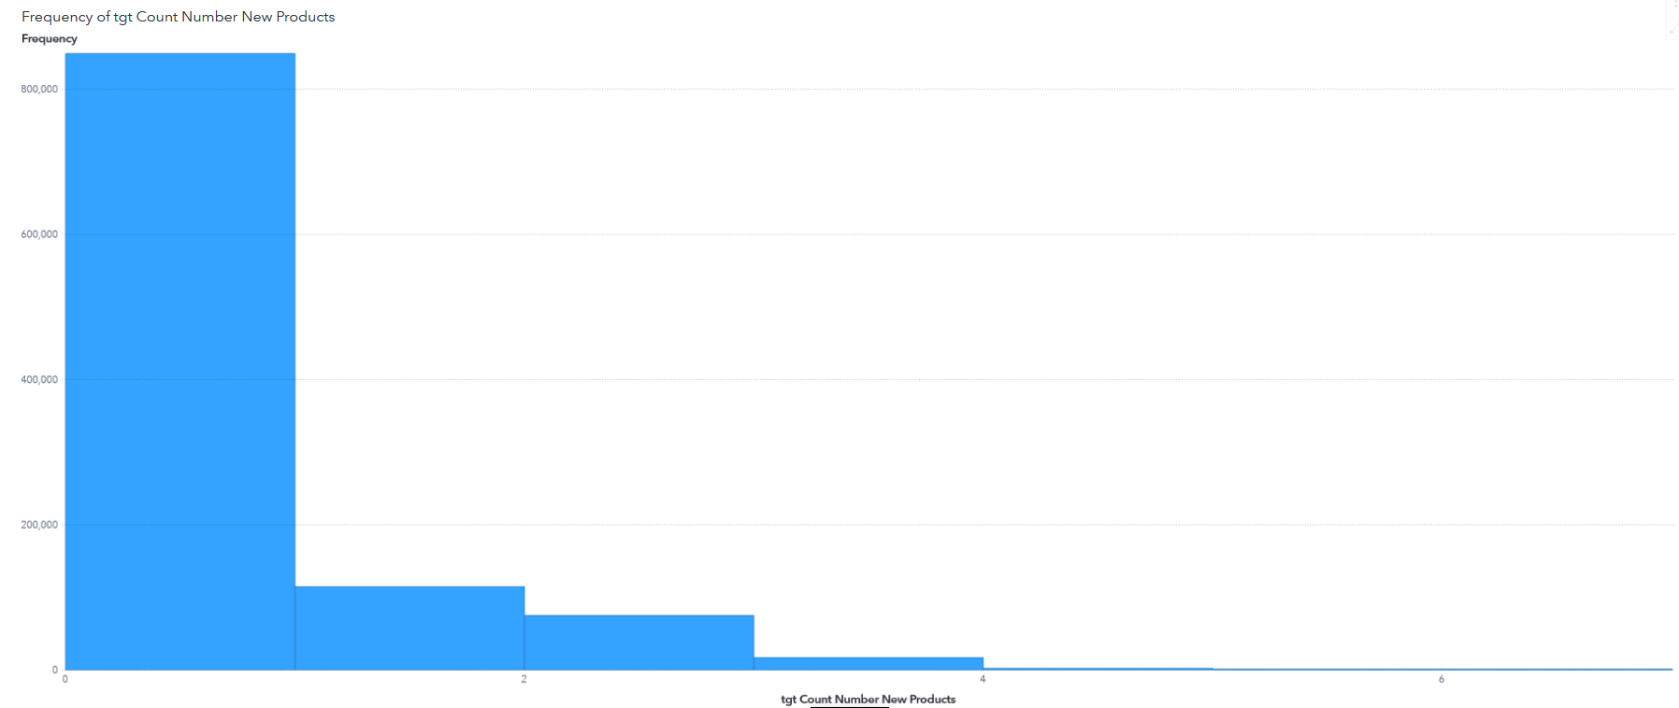
Example
Count Number New Products

Slide 99
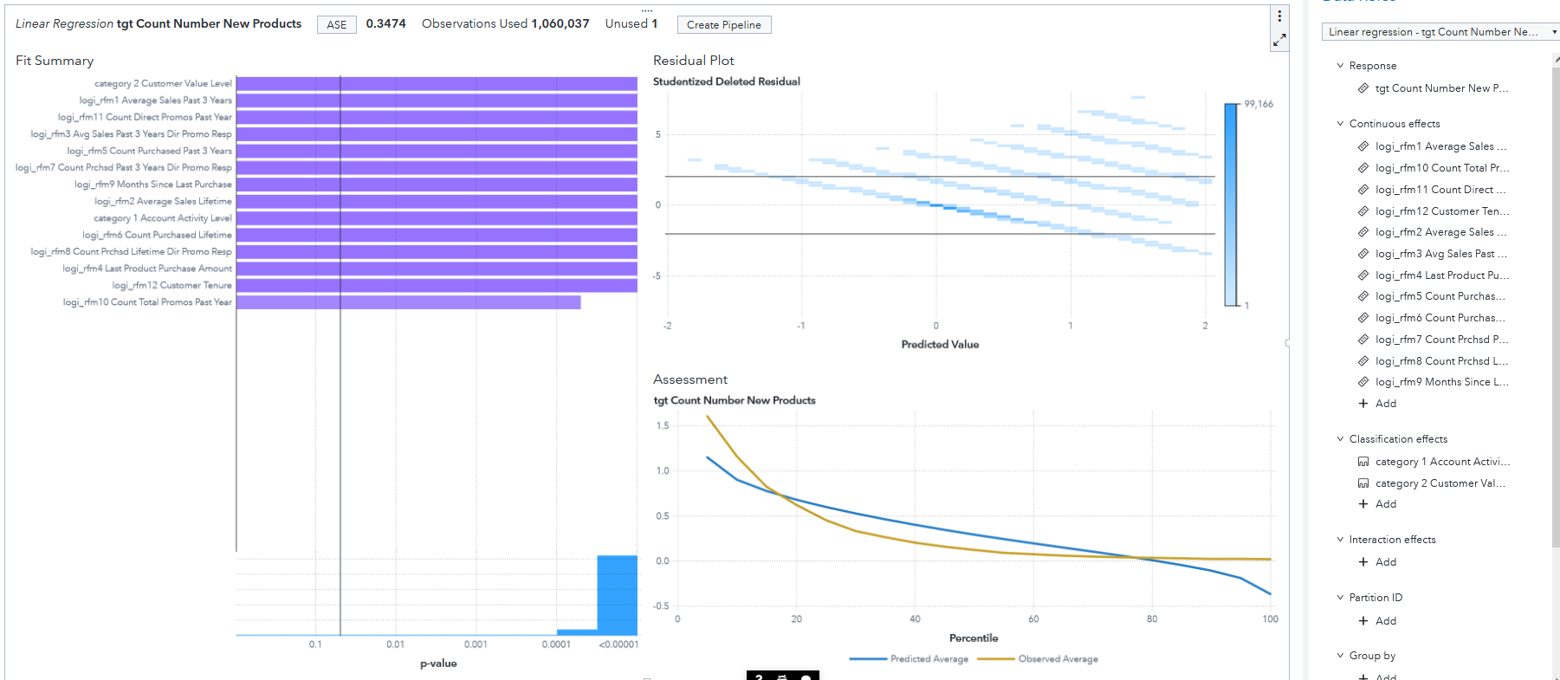
Example
Linear Model
What issues do you see here?

Slide 100
Generalized Linear Models
Extends the linear regression model by incorporating a "link function" and associated probability distribution to change the distribution of the response variable:
where $g(∙)$ can be a variety of functions with a variety of probability distributions
One way of dealing with response variables that are not normally distributed with respect to the predictors
$$g(E(Y|X)=β_{0}+β_{1}X_{1}+β_{2}X_{2}+…+β_{p}X_{p}+ε$$

Slide 101
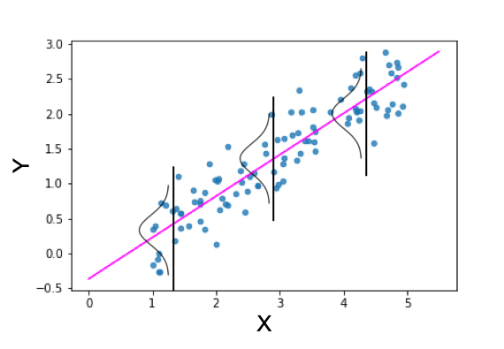

Generalized Linear Models
Linear Regression
Models the mean of a continuous response variable Y
$g(∙)$ is distributed normally with an identity link function:
${Y= β}_{0}+β_{1}X_{1}+β_{2}X_{2}+…+β_{p}X_{p}$

Slide 102

Generalized Linear Models
Binary Logistic Regression
Models the odds of “success” for a binary response variable Y
$g(∙)$ is the logit function with a binomial distribution:
$$logit\left(π_{i}\right)=\log\left(\frac{π_{i}}{1−π_{i}}\right){= β}_{0}+β_{1}X_{1}+β_{2}X_{2}+…+β_{p}X_{p}$$

Slide 103

Generalized Linear Models
Poisson Regression
Models the mean of a discrete (count) response variable Y
$g(∙)$ is the log link function with a Poisson distribution:
$${logλ_{i}= β}_{0}+β_{1}X_{1}+β_{2}X_{2}+…+β_{p}X_{p}$$

Slide 104
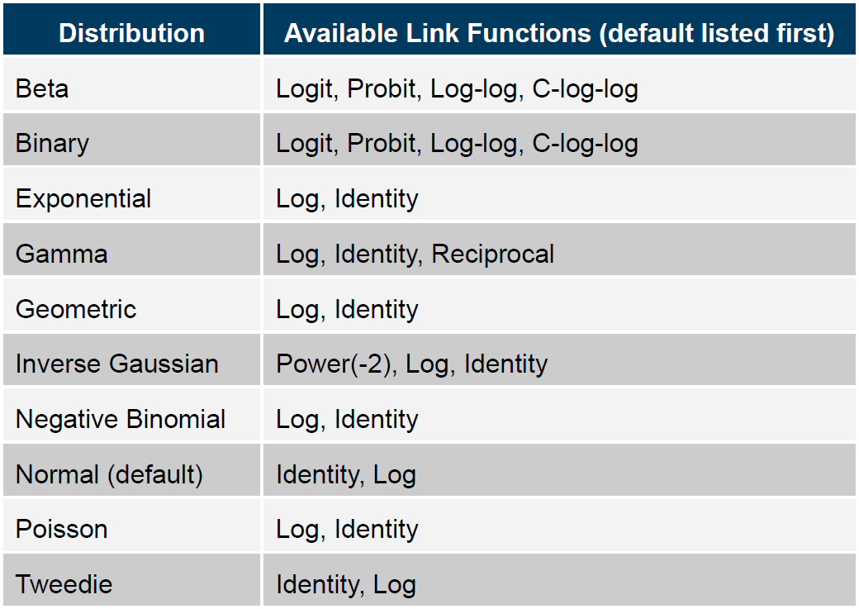
Generalized Linear Models
Common Linear Distributions

Slide 105
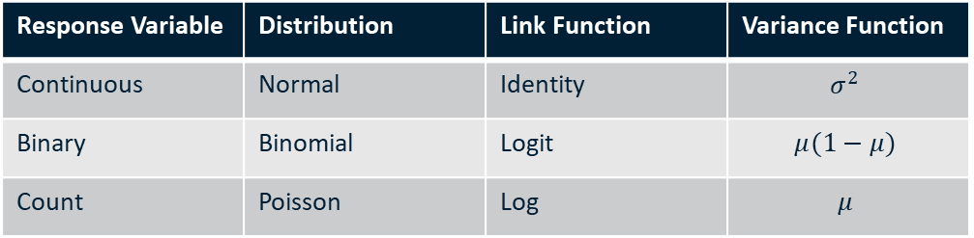
Examples of Popular GLMs
Response Variable | Distribution | Link Function | Variance Function
Continuous | Normal | Identity | $$σ^{2}$$
Binary | Binomial | Logit | $$μ(1−μ)$$
Count | Poisson | Log | $$μ$$

